Slide 1
Java Applets

Slide 2
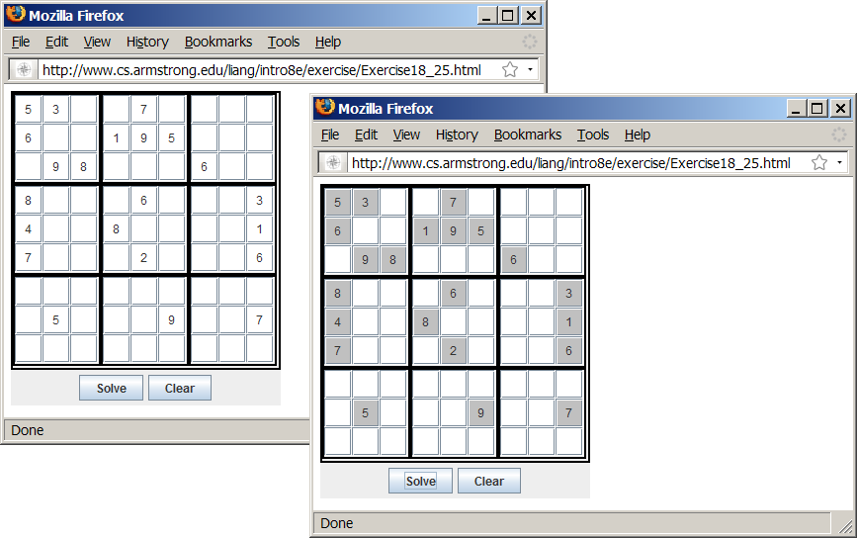
Motivations
When browsing the Web, you frequently see the graphical user interface and animation developed using Java. These programs are called Java applets. Suppose you want to develop a Java applet for the Sudoku game. How do you write this program?
Sudoku

Slide 3
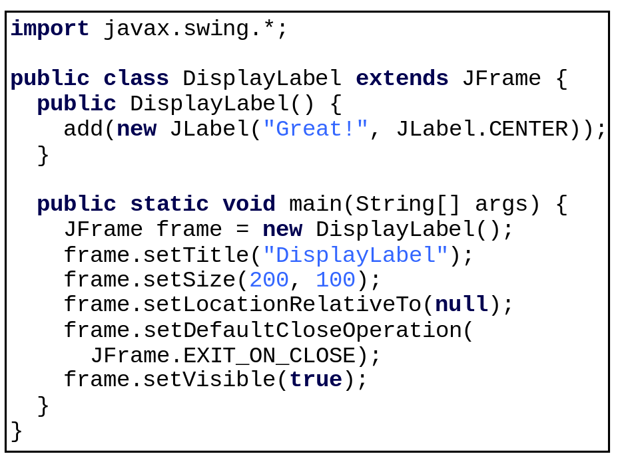
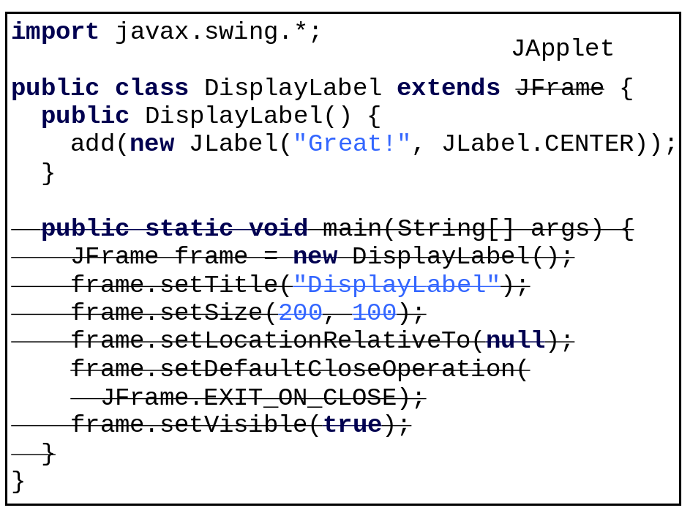
Developing Applets

Slide 4
The <applet> HTML Tag
<applet
code=classfilename.class
width=applet_viewing_width_in_pixels
height=applet_viewing_height_in_pixels
[archive=archivefile]
[codebase=applet_url]
[vspace=vertical_margin]
[hspace=horizontal_margin]
[align=applet_alignment]
[alt=alternative_text]
>
<param name=param_name1
value=param_value1>
</applet>

Slide 5
First Simple Applet
<html>
<head>
<title>Java Applet Demo</title>
</head>
<body>
<applet
code = "DisplayLabel.class"
width = 350
height = 200>
</applet>
</body>
</html>
DisplayLabel
Run Applet Viewer

Slide 6
Applications vs. Applets
Similarities
  Since JFrame and JApplet both are subclasses of the Container class, all the user interface components, layout managers, and event-handling features are the same for both classes.
Differences
  Applications are invoked from the static main method by the Java interpreter, and applets are run by the Web browser. The Web browser creates an instance of the applet using the applet’s no-arg constructor and controls and executes the applet through the init, start, stop, and destroy methods.
  Applets have security restrictions
  Web browser creates graphical environment for applets, GUI applications are placed in a frame.

Slide 7
Security Restrictions on Applets
Applets are not allowed to read from, or write to, the file system of the computer viewing the applets.
Applets are not allowed to run any programs on the browser’s computer.
Applets are not allowed to establish connections between the user’s computer and another computer except with the server where
the applets are stored.

Slide 8
Conversions Between Applications and Applets
Conversions between applications and applets are simple and easy.
You can always convert an applet into an application.
You can convert an application to an
applet as long as security restrictions are
not violated.

Slide 9
Enabling Applets to Run as Applications
import javax.swing.*;
public class DisplayLabel extends JApplet {
public DisplayLabel() {
add(new JLabel("Great!", JLabel.CENTER));
}
public static void main(String[] args) {
// Create a frame
JFrame frame = new JFrame("Applet is in the frame");
// Create an instance of the applet
DisplayLabel applet = new DisplayLabel();
// Add the applet to the frame
frame.add(applet);
// Display the frame
frame.setSize(300, 100);
frame.setLocationRelativeTo(null); // Center the frame
frame.setDefaultCloseOperation(JFrame.EXIT_ON_CLOSE);
frame.setVisible(true);
}
}

Slide 10
The Applet Class
When the applet is loaded, the Web browser creates an instance of the applet by invoking the applet’s no-arg constructor. The browser uses the init, start, stop, and destroy methods to control the applet. By default, these methods do nothing. To perform specific functions, they need to be modified in the user's applet so that the browser can call your code properly.

Slide 11
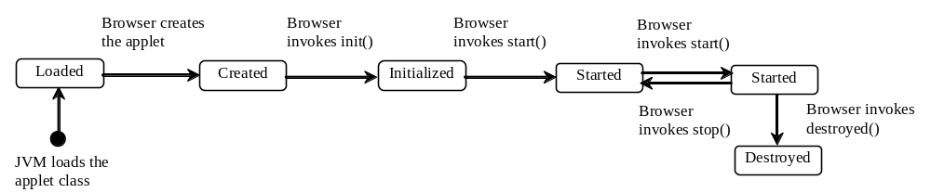
Browser Calling Applet Methods

Slide 12
The init() Method
Invoked when the applet is first loaded and again if the applet is reloaded.
A subclass of Applet should override this method if the subclass has an initialization to perform. The functions usually implemented in this method include creating new threads, loading images, setting up user-interface components, and getting string parameter values from the <applet> tag in the HTML page.

Slide 13
The start() Method
Invoked after the init() method is executed; also called whenever the applet becomes active again after a period of inactivity (for example, when the user returns to the page containing the applet after surfing other Web pages).
A subclass of Applet overrides this method if it has any operation that needs to be performed whenever the Web page containing the applet is visited. An applet with animation, for example, might use the start method to resume animation.

Slide 14
The stop() Method
The opposite of the start() method, which is called when the user moves back to the page containing the applet; the stop() method is invoked when the user moves off the page.
A subclass of Applet overrides this method if it has any operation that needs to be performed each time the Web page containing the applet is no longer visible. When the user leaves the page, any threads the applet has started but not completed will continue to run. You should override the stop method to suspend the running threads so that the applet does not take up system resources when it is inactive.

Slide 15
The destroy() Method
Invoked when the browser exits normally to inform the applet that it is no longer needed and that it should release any resources it has allocated.
A subclass of Applet overrides this method if it has any operation that needs to be performed before it is destroyed. Usually, you won't need to override this method unless you wish to release specific resources, such as threads that the applet created.

Slide 16
Writing Applets
Always extends the JApplet class, which is a subclass of Applet for Swing components.
Override init(), start(), stop(), and destroy() if necessary. By default, these methods are empty.
Add your own methods and data if necessary.
Applets are always embedded in an
HTML page.

Slide 17
Passing Parameters to Applets
<applet
code = "DisplayMessage.class"
width = 200
height = 50>
<param name=MESSAGE value="Welcome
to Java">
<param name=X value=20>
<param name=Y value=20>
alt="You must have a Java-enabled browser to view the applet"
</applet>

Slide 18
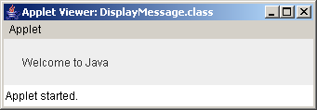
Example: Passing Parameters to Java Applets
Objective: Display a message at a specified location. The message and the location (x, y) are obtained from the HTML source.

